Slide 1
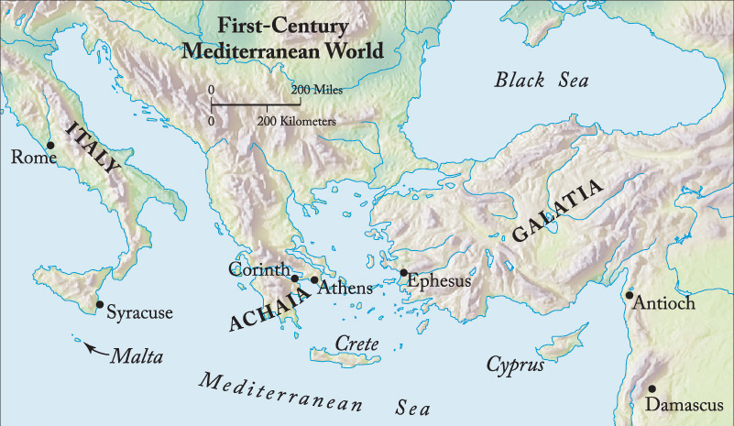
Philippians 2:19-30
Selfless Servants!
Preached by Dan Bridges Amman International Church, Jordan (AmmanChurch.org) Uploaded by Dr. Rick Griffith • Jordan Evangelical Theological Seminary Files in many languages for free download at BibleStudyDownloads.org

Slide 2
¹⁹ I hope in the Lord Jesus to send Timothy to you soon, so that I too may be cheered by news of you. ²⁰ For I have no one like him, who will be genuinely concerned for your welfare. ²¹ For they all seek their own interests, not those of Jesus Christ. ²² But you know Timothy's proven worth, how as a son with a father he has served with me in the gospel. ²³ I hope therefore to send him just as soon as I see how it will go with me, ²⁴ and I trust in the Lord that shortly I myself will come also.
Philippians 2:19-24

Slide 3
²⁵ I have thought it necessary to send to you Epaphroditus my brother and fellow worker and fellow soldier, and your messenger and minister to my need, ²⁶ for he has been longing for you all and has been distressed because you heard that he was ill. ²⁷ Indeed he was ill, near to death. But God had mercy on him, and not only on him but on me also, lest I should have sorrow upon sorrow.
Philippians 2:25-27

Slide 4
²⁸ I am the more eager to send him, therefore, that you may rejoice at seeing him again, and that I may be less anxious. ²⁹ So receive him in the Lord with all joy, and honor such men, ³⁰ for he nearly died for the work of Christ, risking his life to complete what was lacking in your service to me.
Philippians 2:28-30

Slide 5
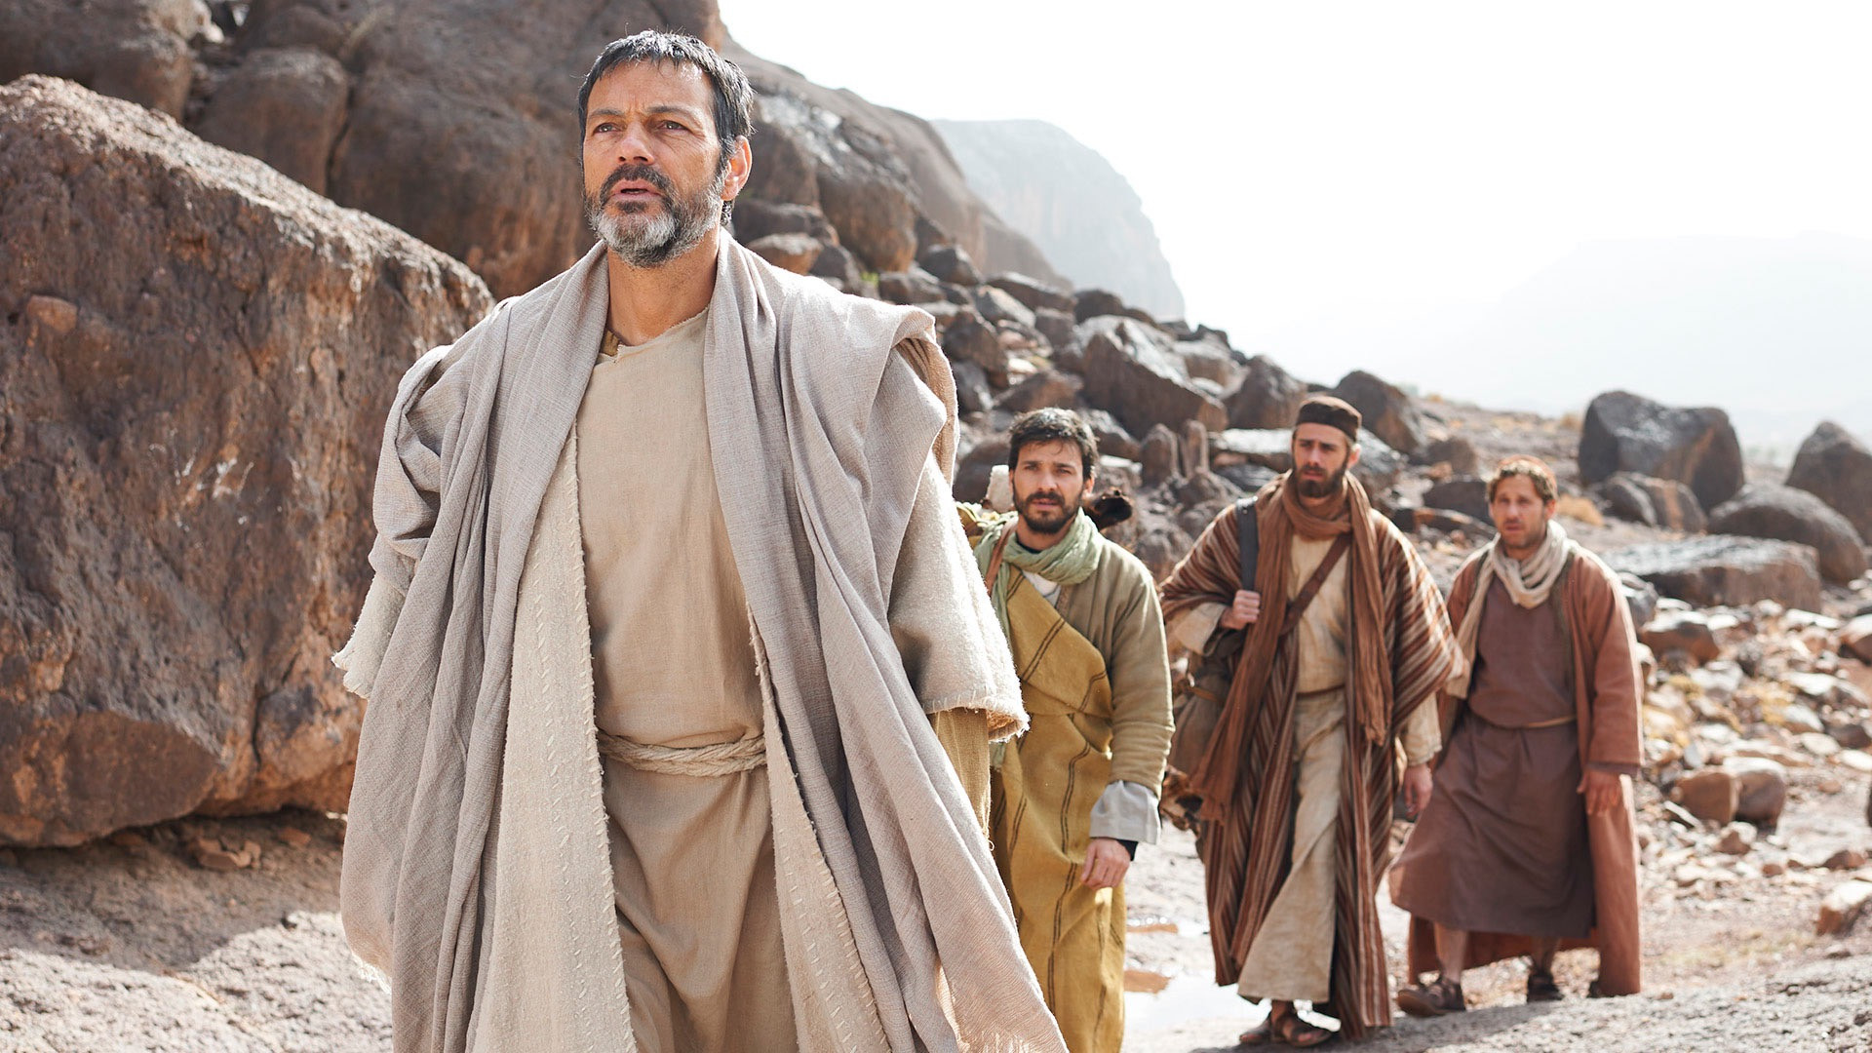
Paul
Timothy
Epaphroditus

Slide 6
The Background…

Slide 7
Second Missionary Journey
Philippi
Thessalonica
Athens
Lystra
Antioch
A Riot…
Paul had to leave at night!

Slide 8
Second Missionary Journey
But since we were torn away from you, brothers, for a short time… we endeavored the more eagerly and with great desire to see you face to face, because we wanted to come to you… Therefore when we could bear it no longer, we were willing to be left behind at Athens alone, and we sent Timothy… to establish and exhort you in your faith, that no one be moved by these afflictions.
1 Thessalonians 2:18-3:3

Slide 9
Second Missionary Journey
Philippi
Thessalonica
Athens
Lystra
Antioch
Timothy sent to Thessalonica
Notes:
According to 1 Thess 3, Timothy went from Athens to Thessalonica
According to Acts 18:5, Timothy and Silas rejoined Paul in Corinth

Slide 10
Third Missionary Journey
Problems in Corinth
Ephesus
Corinth
Antioch
Timothy sent to Corinth

Slide 11
Paul in Prison in Rome
Paul in Prison
Rome
Philippi
Epaphroditus sent To Rome
With a gift
With News (disunity!)
Most likely intended to stay with Paul

Slide 12
Paul in Prison in Rome
Rome
Philippi
Epaphroditus gets sick
News gets back to Philippi
News gets back to Epaphroditus
Epaphroditus is distressed!

Slide 13
Paul in Prison in Rome
Rome
Philippi
Current Situation in Rome:
Paul was about to find out his verdict
Paul was concerned with news from Epaphroditus of disunity in Philippi
Epaphroditus was distressed that the Philippians were worrying about him

Slide 14
Paul’s Decision
To send Epaphroditus back to Philippi with a letter
(Encouraging them / thanking them / exhorting them to unity)
To wait until his verdict was clear and then send Timothy
(Communicate verdict and follow up letter)

Slide 15
Why Take Time for this Illustration?
What can we learn from all the people traffic?
Ordinary people were putting extraordinary effort into supporting each other and spurring each other on to love and good deeds
Ordinary people willingly accepted the dangers and risks of travel in order to put the interests of Jesus and others before their own.

Slide 16
The Dangers of 1st Century Travel
²⁵ Three times I was shipwrecked; a night and a day I was adrift at sea; ²⁶ on frequent journeys, in danger from rivers, danger from robbers, danger from my own people, danger from Gentiles, danger in the city, danger in the wilderness, danger at sea, danger from false brothers; ²⁷ in toil and hardship, through many a sleepless night, in hunger and thirst, often without food, in cold and exposure.
Notes:
It is estimated that it would have taken 6-8 weeks to travel between Rome and Philippi

Slide 17
Philippians 2:19-30 – Why is it Here?
Philippians 2:2 – A Call to Unity!
Humility (Philippians 2:3)
Selflessness (Philippians 2:4)
Examples of Humility / Selflessness
Jesus (2:5-11)
Paul
Timothy
Epaphroditus

Slide 18
Paul’s Character
¹⁹ I hope in the Lord Jesus to send Timothy to you soon, so that I too may be cheered by news of you. ²⁰ For I have no one like him, who will be genuinely concerned for your welfare. ²¹ For they all seek their own interests, not those of Jesus Christ. ²² But you know Timothy's proven worth, how as a son with a father he has served with me in the gospel. ²³ I hope therefore to send him just as soon as I see how it will go with me, ²⁴ and I trust in the Lord that shortly I myself will come also.
Philippians 2:19-24
Why did Paul want to send someone?
He was very concerned with their disunity
Hearing good news would genuinely cheer him!
Paul, in prison, was deeply concerned about others – as a parent for the children!

Slide 19
Paul’s Character
¹⁹ I hope in the Lord Jesus to send Timothy to you soon, so that I too may be cheered by news of you. ²⁰ For I have no one like him, who will be genuinely concerned for your welfare. ²¹ For they all seek their own interests, not those of Jesus Christ. ²² But you know Timothy's proven worth, how as a son with a father he has served with me in the gospel. ²³ I hope therefore to send him just as soon as I see how it will go with me, ²⁴ and I trust in the Lord that shortly I myself will come also.
Philippians 2:19-24
Why did Paul want to send Timothy?
Paul wanted to send Timothy because Paul was genuinely concerned for their welfare!

Slide 20
Paul’s Character
Paul was anxious for the Philippians to know what happened to him.
Even sending Timothy was not enough for Paul – he wanted to come too!
Real relationships / real emotions!
¹⁹ I hope in the Lord Jesus to send Timothy to you soon, so that I too may be cheered by news of you. ²⁰ For I have no one like him, who will be genuinely concerned for your welfare. ²¹ For they all seek their own interests, not those of Jesus Christ. ²² But you know Timothy's proven worth, how as a son with a father he has served with me in the gospel. ²³ I hope therefore to send him just as soon as I see how it will go with me, ²⁴ and I trust in the Lord that shortly I myself will come also.
Philippians 2:19-24

Slide 21
Timothy’s Character
¹⁹ I hope in the Lord Jesus to send Timothy to you soon, so that I too may be cheered by news of you. ²⁰ For I have no one like him, who will be genuinely concerned for your welfare. ²¹ For they all seek their own interests, not those of Jesus Christ. ²² But you know Timothy's proven worth, how as a son with a father he has served with me in the gospel. ²³ I hope therefore to send him just as soon as I see how it will go with me, ²⁴ and I trust in the Lord that shortly I myself will come also.
Philippians 2:19-24
Pattern of Selflessness
Pattern of Humility

Slide 22
Most People’s Character
¹⁹ I hope in the Lord Jesus to send Timothy to you soon, so that I too may be cheered by news of you. ²⁰ For I have no one like him, who will be genuinely concerned for your welfare. ²¹ For they all seek their own interests, not those of Jesus Christ. ²² But you know Timothy's proven worth, how as a son with a father he has served with me in the gospel. ²³ I hope therefore to send him just as soon as I see how it will go with me, ²⁴ and I trust in the Lord that shortly I myself will come also.
Philippians 2:19-24

Slide 23
Epaphroditus
The Problem:
Paul is sending Epaphroditus back, but the Philippians had most likely intended him to stay. Was he quitting?
Paul takes great effort to speak for the character of Epaphroditus and to ensure that he is honored upon his return.
Notes:
Another reason for the letter! And Epaphroditus was carrying it.
Because of this, we get a lot of insight into Epaphroditus’ character!

Slide 24
Epaphroditus’ Character
²⁵ I have thought it necessary to send to you Epaphroditus my brother and fellow worker and fellow soldier, and your messenger and minister to my need, ²⁶ for he has been longing for you all and has been distressed because you heard that he was ill. ²⁷ Indeed he was ill, near to death. But God had mercy on him, and not only on him but on me also, lest I should have sorrow upon sorrow.
Philippians 2:25-27
Jew and Gentile – brothers!
Not just in Rome, but actively working to spread the gospel
“In the trenches” with Paul
Notes:
Epaphroditus – name comes from Aphrodite (Greek goddess of love and beauty)
(He was clearly from a pagan Gentile family)

Slide 25
Epaphroditus’ Character
²⁵ I have thought it necessary to send to you Epaphroditus my brother and fellow worker and fellow soldier, and your messenger and minister to my need, ²⁶ for he has been longing for you all and has been distressed because you heard that he was ill. ²⁷ Indeed he was ill, near to death. But God had mercy on him, and not only on him but on me also, lest I should have sorrow upon sorrow.
Philippians 2:25-27
Messenger – literally “apostle” – sent one
Minister – like a priest
Notes:
Epaphroditus – name comes from Aphrodite (Greek goddess of love and beauty)
(He was clearly from a pagan Gentile family)

Slide 26
Epaphroditus’ Character
²⁵ I have thought it necessary to send to you Epaphroditus my brother and fellow worker and fellow soldier, and your messenger and minister to my need, ²⁶ for he has been longing for you all and has been distressed because you heard that he was ill. ²⁷ Indeed he was ill, near to death. But God had mercy on him, and not only on him but on me also, lest I should have sorrow upon sorrow.
Philippians 2:25-27
Longing for – intense emotion
Distressed – almost overwhelmed with sorrow
or burden of mind
Notes:
Not distressed that he was ill, but distressed that they would be worried about him!

Slide 27
Epaphroditus’ Character
²⁸ I am the more eager to send him, therefore, that you may rejoice at seeing him again, and that I may be less anxious. ²⁹ So receive him in the Lord with all joy, and honor such men, ³⁰ for he nearly died for the work of Christ, risking his life to complete what was lacking in your service to me.
Philippians 2:28-30
Risking his life – gambling with his life
Notes:
Not distressed that he was ill, but distressed that they would be worried about him!

Slide 28
What Can We Learn?
God has called us to humility and selflessness…
Humility:
Like Timothy:
To do what needs doing – even if it’s not my idea
To serve as a son/daughter (not as the boss!)
Like Epaphroditus: Caring for friends and family even at the possible cost of looking like a failure
Like Paul: Honoring Timothy & Epaphroditus

Slide 29
What Can We Learn?
God has called us to humility and selflessness…
Selflessness:
Caring for the needs of others – even when we ourselves have huge problems!
Being interested in the lives / work / family / ministries of others
Sacrificing personal interests for the sake of others

Slide 30
What Can We Learn?
God has called us to humility and selflessness…
It takes great, intentional effort to
Really love each other
Support each other
Spur one another on to love and good deeds

Slide 32
NT Preaching link at BibleStudyDownloads.org
Get this presentation for free!
Notes:
NT Preaching (np)

